Slide 1
Incident Handling and responses (Assignment-1)
Topic 4- Performing Device Driver Monitoring

Slide 2
Name of the Student- Maisha Khatoon
Student ID- 100899259

Slide 3
Table of Content
What is a Device Driver?
What is Device Driver Monitoring?
Monitoring
How does Driver Booster work?
Installation and process of using Driver Booster in my PC:

Slide 4
What is a Device Driver?
The computer is made of three layers- the operating system layer, application layer, and hardware layer. The users interact with the application layer whereas the application layer interacts with the operating system layer which interacts or works as a middleman between the application layer and the hardware layer. Whenever new hardware is to be plugged into the computer or a new job is to be done, to understand the functionality of each task or in easy words to get the output properly different specific device drivers are working in the computer. For example, if a new printer is plugged into the computer, a printer driver is to be installed so that it can make communication between the hardware and operating system. Some device drivers are already there in the computer but sometimes it is needed to install some device driver for performing specific tasks in the computer.

Slide 5
What is Device Driver Monitoring?
Now, to improve the job efficiency of each piece of hardware in the pc it is very important to monitor device drivers. Monitoring device drivers is a process for managing the performance of the software components or drivers that control the hardware devices in a computer system. Monitoring device drivers increase the efficiency of the overall system by improving the stability of the operation of the devices. Monitoring also helps in fixing bugs and improving performance by updating, detecting, and resolving the drivers. The process also includes monitoring malfunctions or failures.

Slide 6
What is Device Driver Monitoring?
Device driver monitoring functions by continuously keeping track of the health of the drivers and devices in a computer system. It makes use of a variety of methods to gather information, such as-
System logs: System logs are examined for incidents involving driver or device problems. These events can provide important information regarding problems with drivers or equipment.
Execution measurements: The display of components and their drivers are examined to spot any signs of problems, such as poor performance, increased error rates, or unforeseen accidents.

Slide 7
What is Device Driver Monitoring?
Driver inspection: The system sorts the installed drivers and looks for fixes or similarity problems. This can help to identify outdated drivers that need to be updated.
Device correspondence: To spot any problems that could be caused by a failing drive, the communications between the operating framework and the hardware devices are studied.
Device driver monitoring can take automated action to identify problems or get ready for them using the information gathered. For instance, it can subsequently update out-of-date drivers, settle driver conflicts, or get directors ready for problems that need to be attended to.

Slide 8
Monitoring
Here, I have chosen Driver Booster as a software tool to monitor the device driver in my PC. My PC is windows 11 version.

Slide 9
How does Driver Booster work?
This software tool will help to automate the process of updation. The design of this software helps the drivers to stay up-to-date. Moreover, it will improve the performance of the hardware devices in the computer system where it is installed. The Driver Booster is enabled to use a huge range of databases of drivers from manufacturers. This range of databases helps in installing the latest versions of drivers automatically as well it is automated to detect any hardware changes instantly and it updates the drivers according to the changes. The other jobs of this software include backing up and restoring drivers for future use during a system crash.
The following screenshot shows how Driver Booster can be enabled to create a restore point before updating the drivers in my PC:

Slide 10
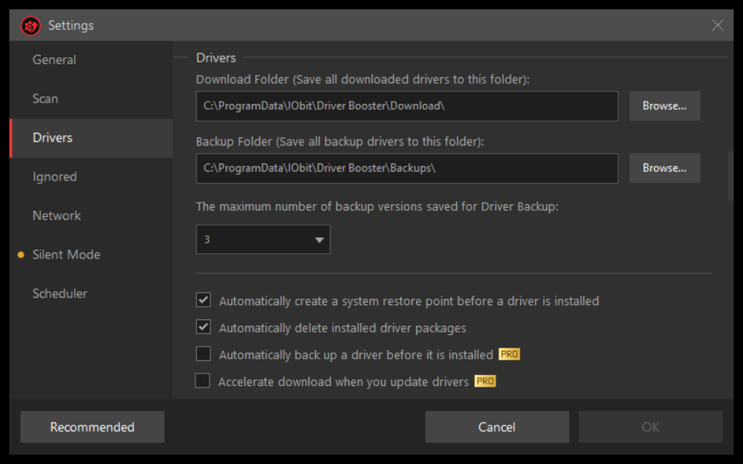

Slide 11
Installation and process of using Driver Booster in my PC:
In general, this is an easy task to perform. So, to start with, first I downloaded the Driver Booster Software and installed it on my computer. Then I enabled the software to create a restore point. After performing the updation, Driver Booster asked my computer to restart the device since it is required to install the updates. The following screenshots will provide information about the process:

Slide 12
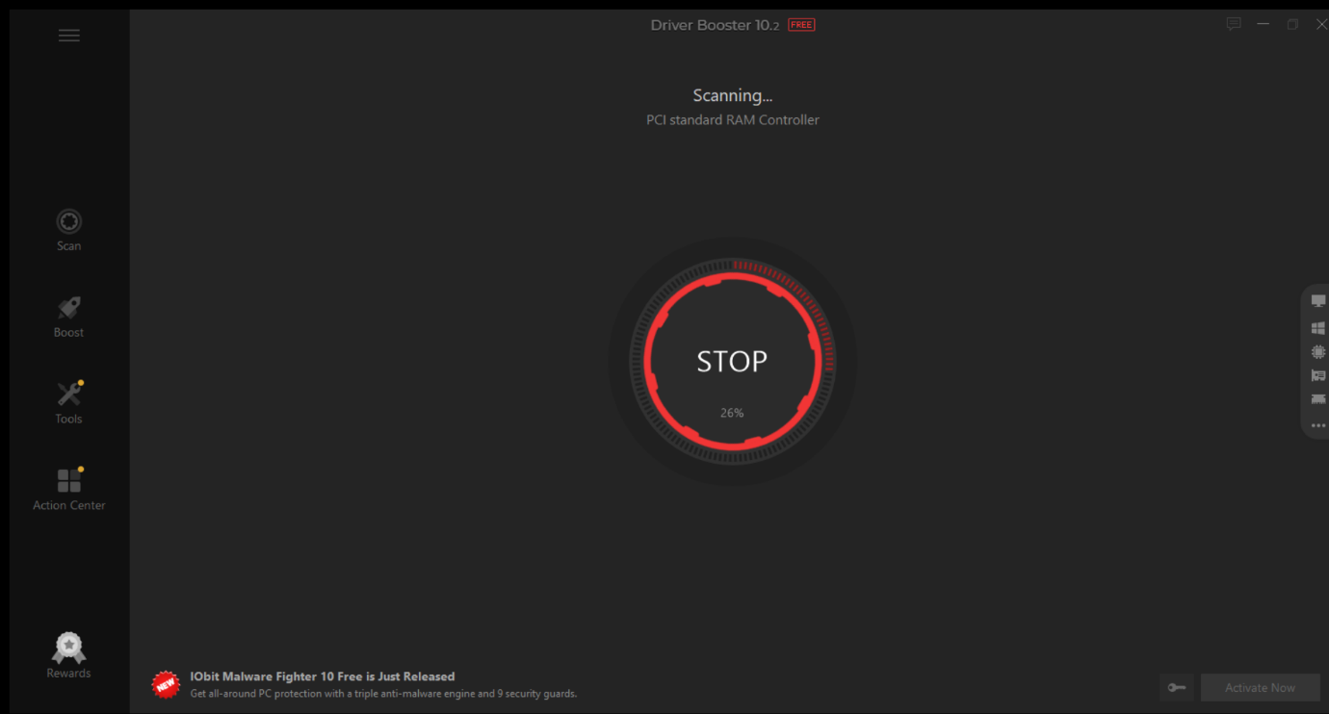
Installation and process of using Driver Booster in my PC:
In this image , the software is scanning whether the drivers need to be updated or not

Slide 13
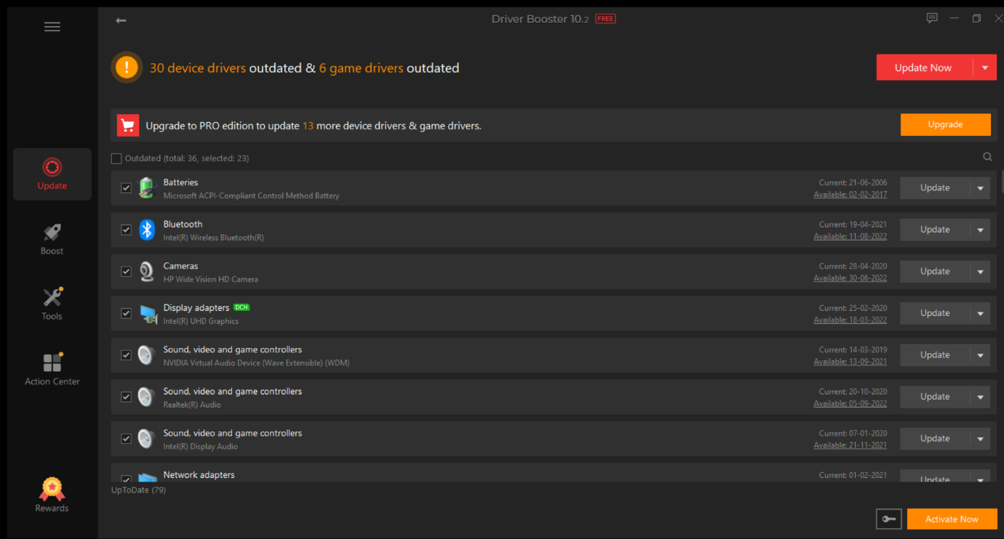
Installation and process of using Driver Booster in my PC:
This screenshot shows what are the drivers that need to be updated.

Slide 14
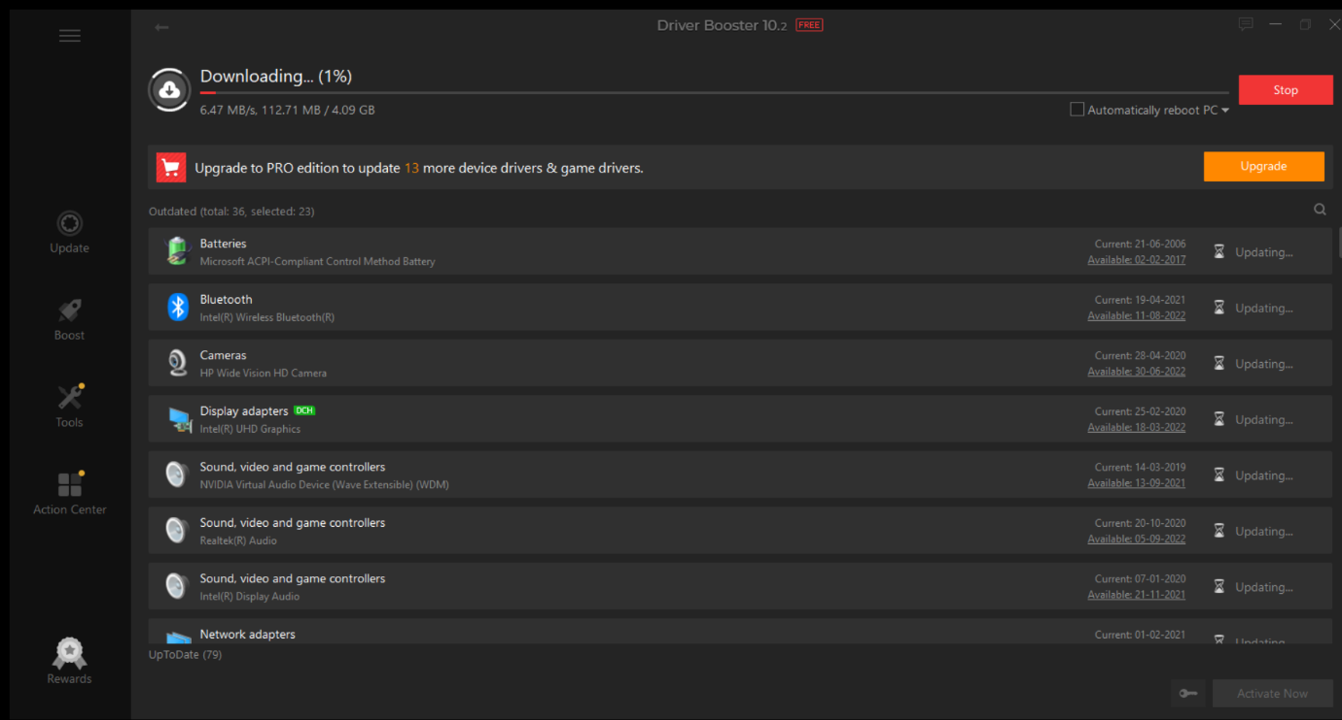
Installation and process of using Driver Booster in my PC:
This screenshot shows that the updates are downloading.

Slide 15
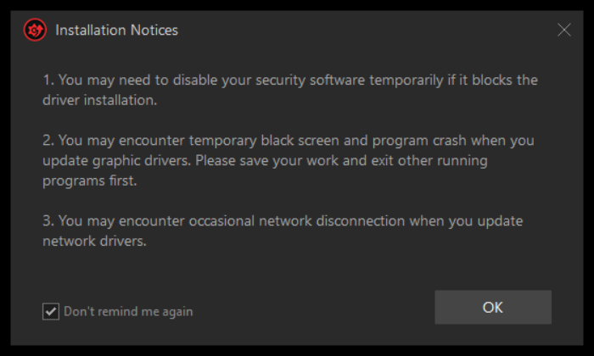
Installation and process of using Driver Booster in my PC:
In this screenshot , the driver booster pops-up a notification about the installation notices. Three bullet points in the screenshot are the things that you need to do during or after the installation.

Slide 16
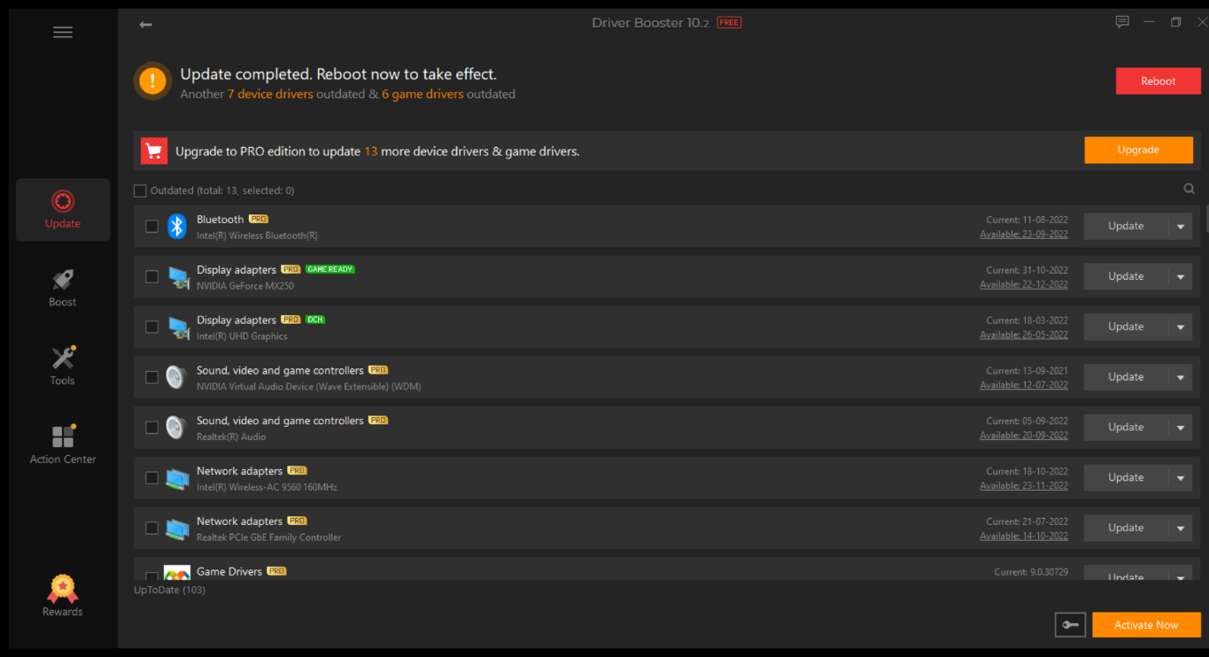
Installation and process of using Driver Booster in my PC:
This screenshot shows that the updation process is complete and you need to reboot your PC.
Once, the updation was complete, I restarted my device to run it smoothly.

